Slide 1

How we at Zillow
Arish Labroo
https://github.com/zillow/howwegoatzillow

Slide 2
Goals
Consistency
Every service should look and feel the same.
Maintainability
Upgrades should not be a multi year effort
Resiliency
100% SLA 🤪
Observability
Logging, Metrics, Tracing
Testability
Yeah, unit testing is cool, but have you tried integration testing?

Slide 3
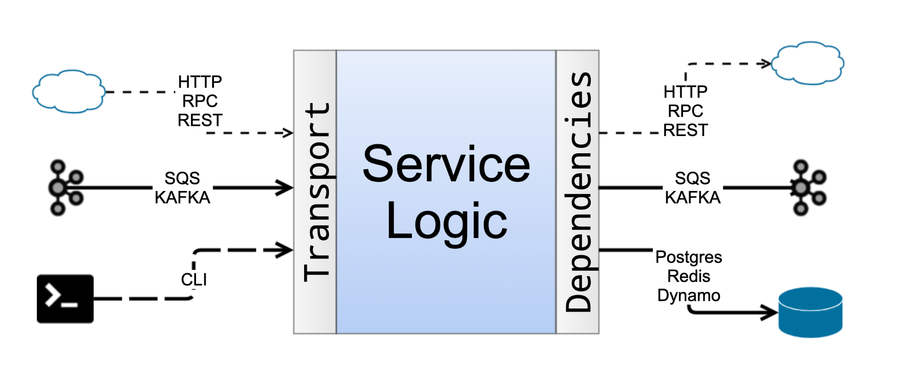
Logging
Tracing
Metrics
Context
Config
Notes:
Stress on transport agnostic.
Json body unmarshall
Proto decode
Kafka message decode all happens at transport layer.
No matter the transpost, service layer sees one consistent request type.

Slide 4
SERVER

Slide 5
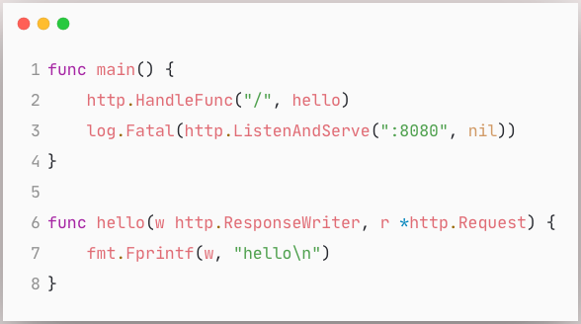
Server
Timeouts
Graceful Shutdown
Instrumentation
Distributed Tracing
Context Propagation
HealthCheck and Probes
Swagger

Slide 6
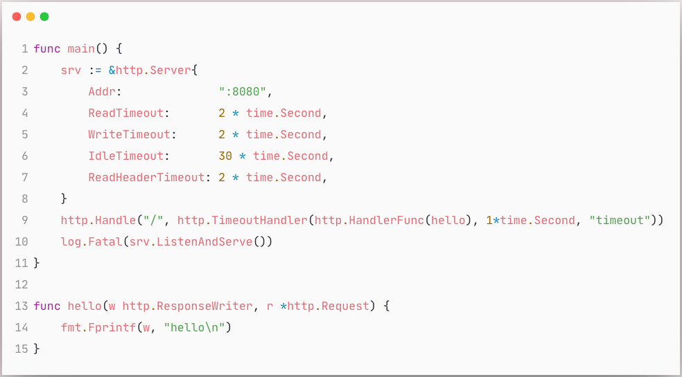
Server: Timeout
Notes:
Slow clients or slow requests adveersely affect performance

Slide 7
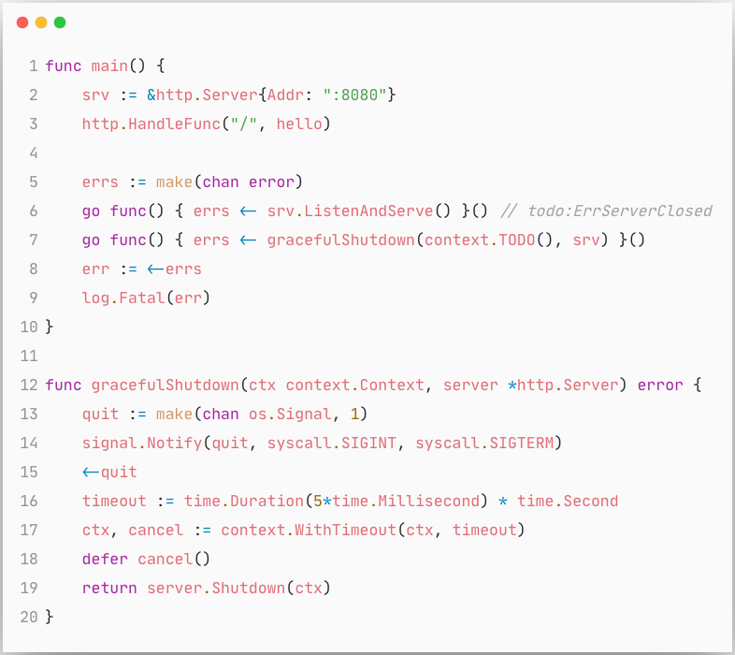
Server: Graceful shutdown
Notes:
Handle Inflight requests gracefully

Slide 8
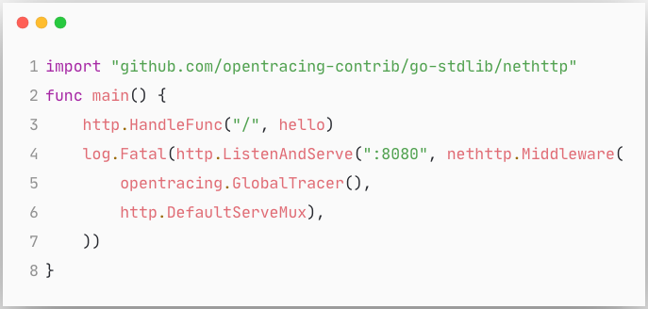
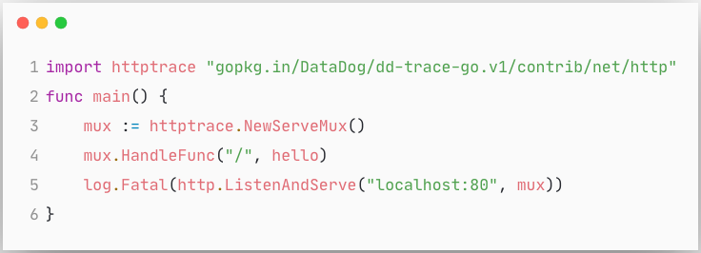
Server: Distributed Tracing
Notes:
throught the talk how pervasive tracing and context propagation is
every ingress and egress participates in distributed tracing

Slide 9
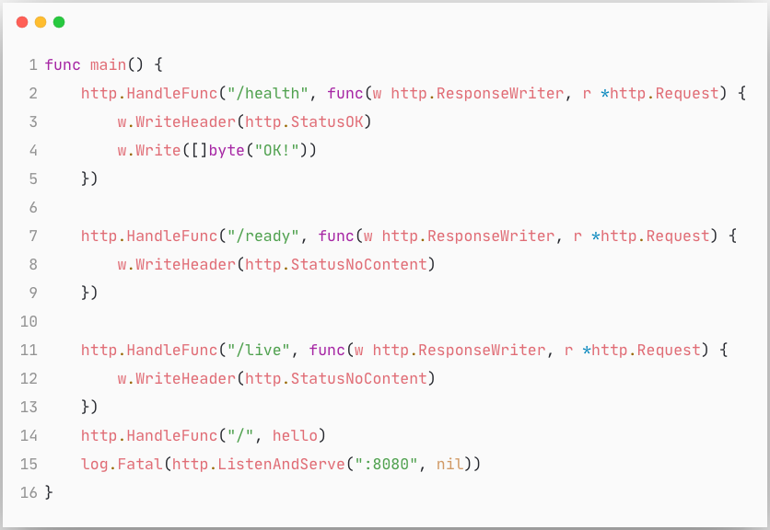
Server: Health Check and Probes
Notes:
check the downstream dependencies in the readiness or health check probes

Slide 10
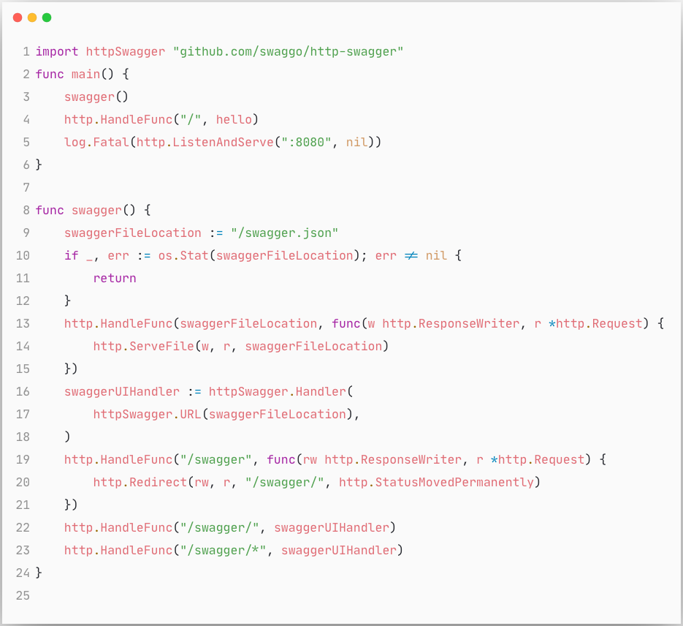
Server: Swagger
Notes:
/swagger endpoint
Contrcts defined in proto
protoc swagger plugin
We use twitch’s twirp rpc framework which is amazing since it does the transport negotiation for us, and both json or binary encoded protobuf requests work out of the box

Slide 11
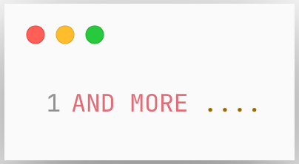
Server ...
Notes:
Logging, Profiling,
Authentication for e.g. if you have auth headers in your request, we want to populate a user in the context automatically.
Custom context propagation, along with distributed tracing context we also have a custom context which we propagate through all the service hops.
This has flags and configurations which influence request handling.
Metrics endpoint for prometheus scrapping for e.g. and etc.

Slide 12
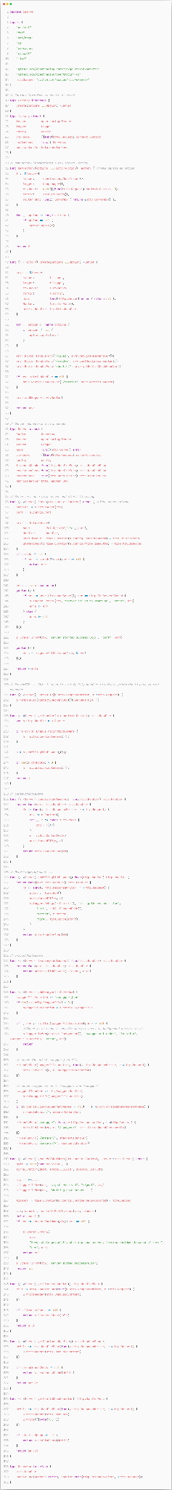

Slide 13
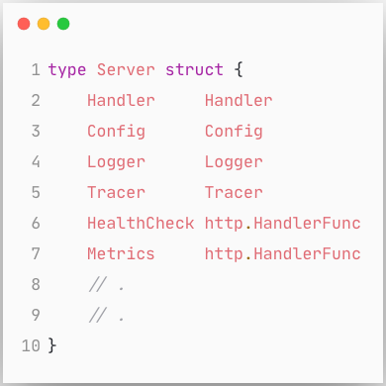
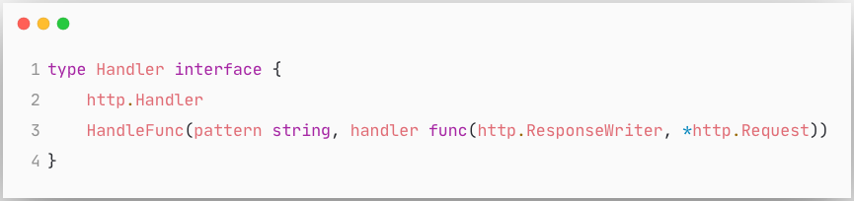
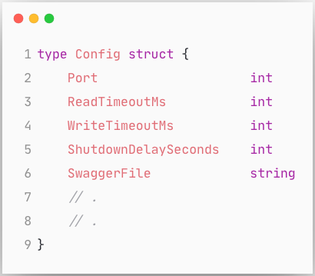
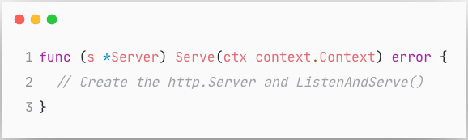
Server
Notes:
We create a server abstraction.
Where Handler could be your default mux, or like I showed earlier datadogs tracing wrapped mux,
or you could adapt the gin engine and pass it as the handler.
All it needs is a HandleFunc.
Config has all the server configurations you want to control.
And other members like an optional logger if you want to plugin your own logger, or pluggable healthcheck handlers and etc.
Server has a Serve method where we actually get the http server instance.
The http server instance here is completely customizable through configuration or functional options pattern.
And then standard listen and serve along with graceful shutdown handling happens here.

Slide 14
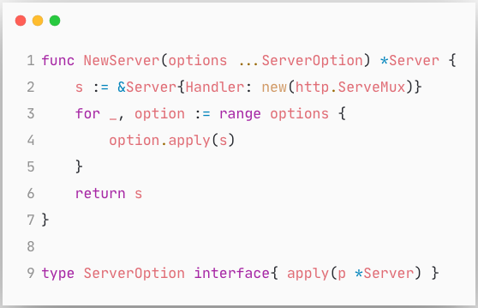
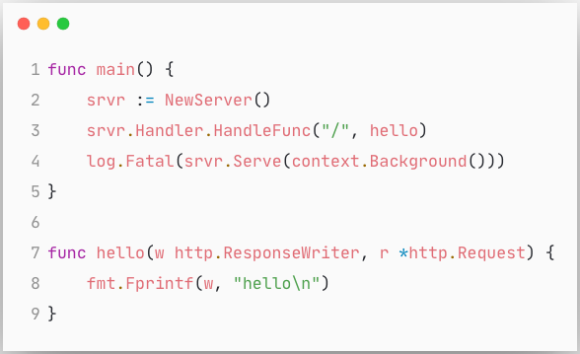
Server
Notes:
Newer where you pass the logger, handler, health check plugs, config etc.
Add all the default routes like probes, swagger, metrics etc.
In your main add the aplication specific routes
And Serve.
Pause
Contextual logger, wrapped mux, tracer, config port timeouts etc.
Cant use defaults for most things. Noop logger
Now the server library we have is not opinionated, but we want all our services to create servers in a standard way with easy path to upgradeability.

Slide 15
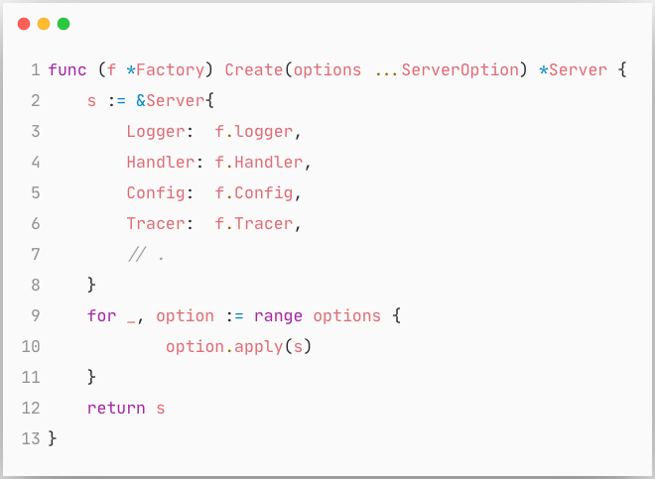
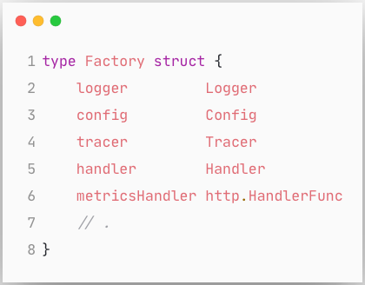
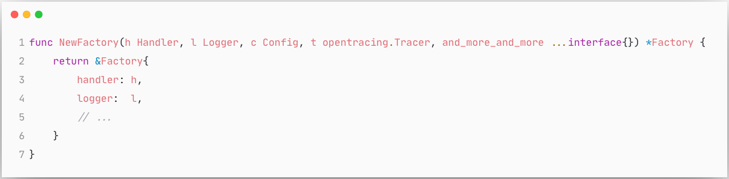
Server: Factory
Notes:
each service does not have to repeat these multi step server setup, we provide a simple server Factory.
And if you just went, eeew Factories .. this is not go… its ok. Factories are not always bad.
To standardize the creation of common types along with their dependencies, factories are actually the perfect pattern
which will create the default server for you with all dependencies correctly
How a factory is iniitalized we will talk in a bit.
For now lets assume a server factory magically appears when you need it with all the members intiialized correctly.

Slide 16
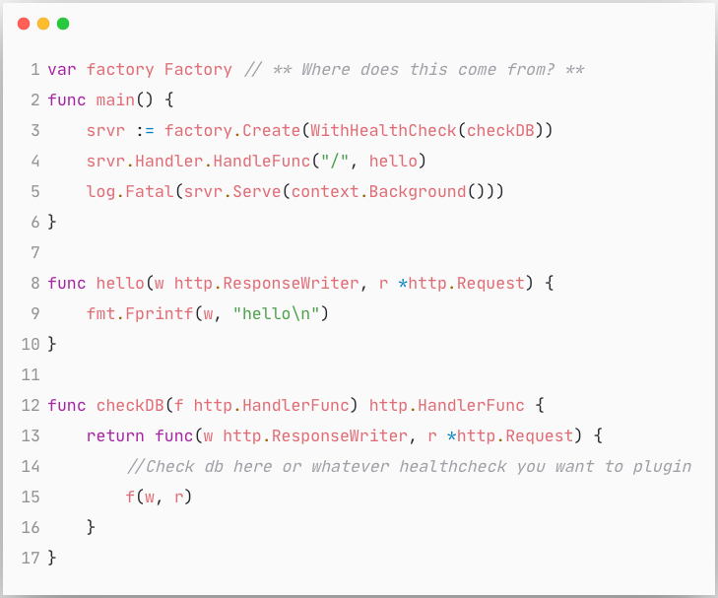
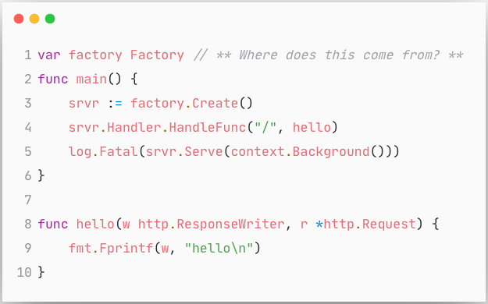
Server: Factory
Notes:
if we ever want to change anything about the server like which tracer to use, or which logger to use by default, or upgrade swagger gen etc,
Or add new global security middlewares,
its all in one place and every application gets its without having to change any code

Slide 17
SERVER
WORKER
Notes:
Workers are long running process usually reading from a message bus, or periodically polling a db, or scheduled cron job like operations.
A lot of our systems are event based where most of the inter service communication is using queues, so we have a lot of these workers.
We will use a simple example of reading from kafka here for e.g.

Slide 18
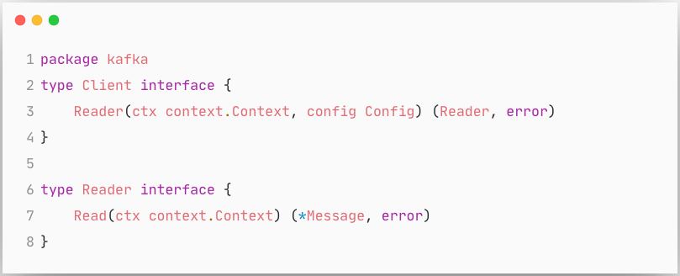
Worker : Kafka Client
Notes:
Composition of this package follows all the same principles, but for now lets assume
We dont care about all the kafka complexities for now.
This could be rabbitmq reader, or aws sqs reader etc.

Slide 19
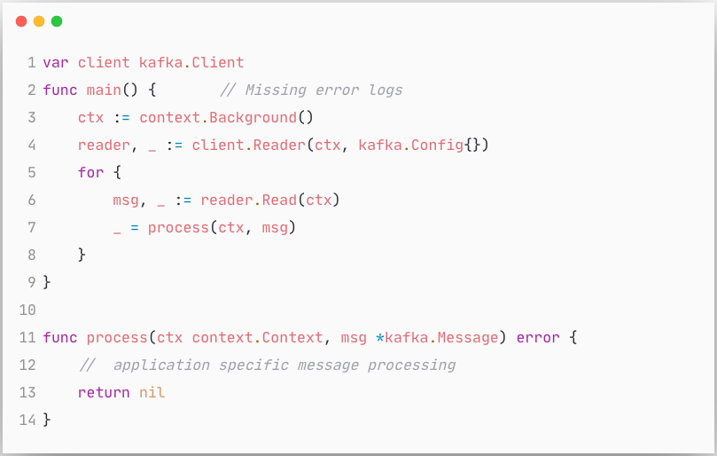
Worker
Timeouts
Graceful Shutdown
Instrumentation
Distributed Tracing
Context Propagation
Concurrency
Circuit Breaker
Error Handling

Slide 20
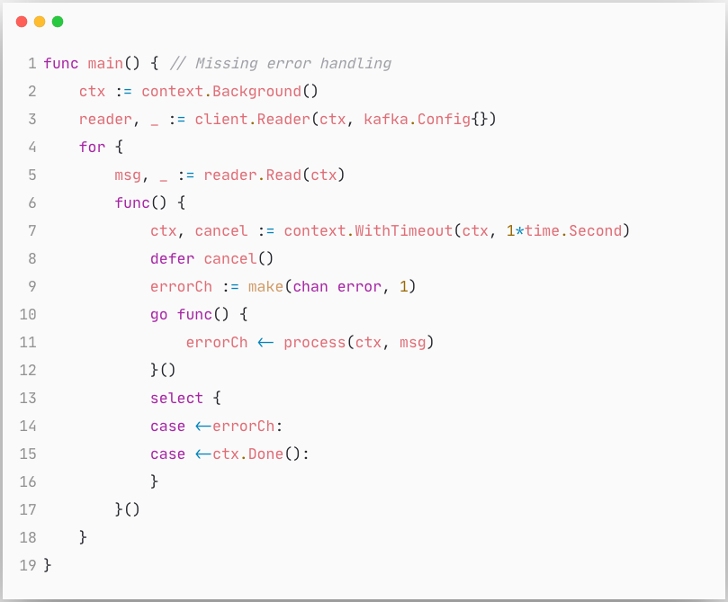
Worker : Timeout
Notes:
Cap the max time you can spend on processing a message.

Slide 21
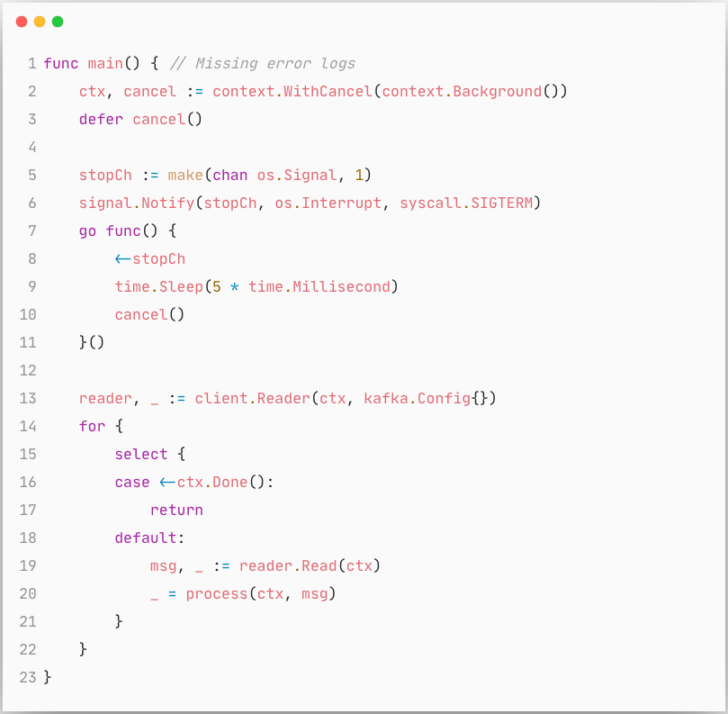
Worker : Graceful Shutdown
Notes:
Listen to signals on a separatee go routine and cancel context
which you are listening to in the for loop

Slide 22
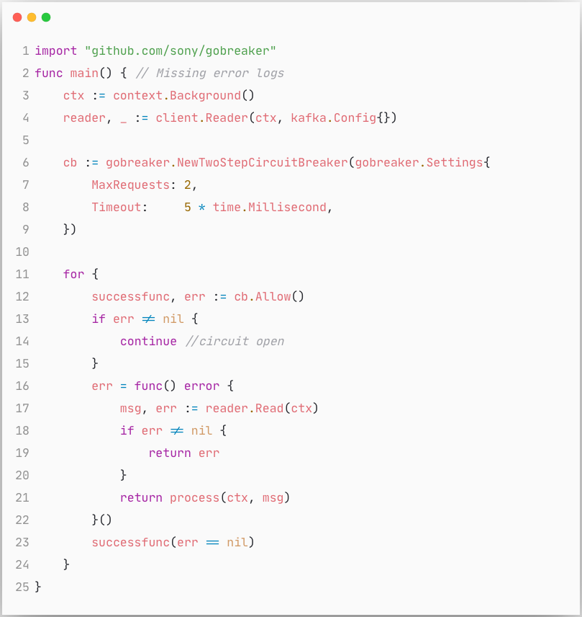
Worker : Circuit Breaker
Notes:
need a configurable circuit breaker.
If message processing is failing above a certain threshold, you want to slow down or stop the rate at which you are consuming messages.

Slide 23
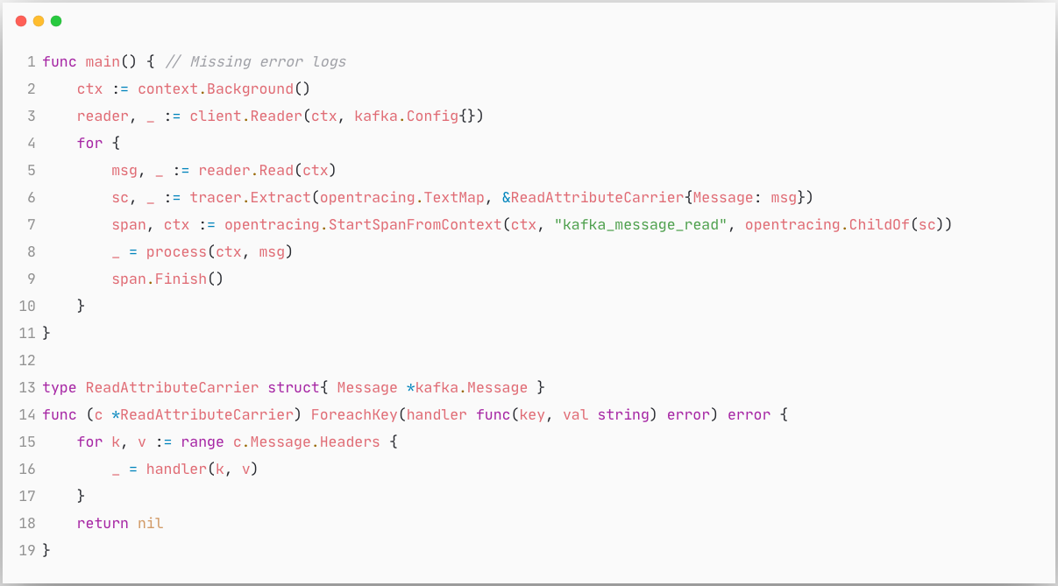
Worker : Distributed Tracing

Slide 24
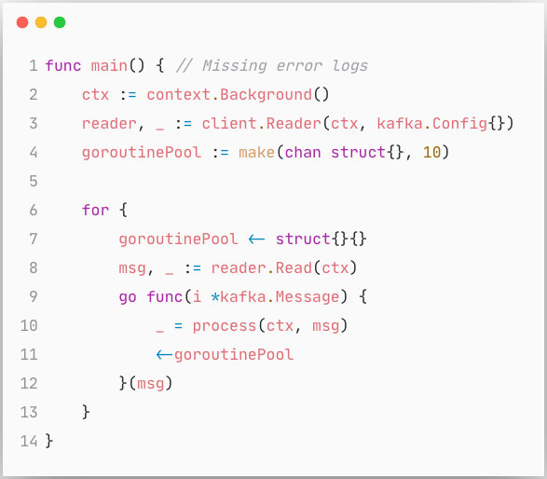
Worker : Concurrency

Slide 25
Worker ...
Notes:
Logging, Profiling, Metrics endpoint, Authentication, Custom Context Propagation...

Slide 27
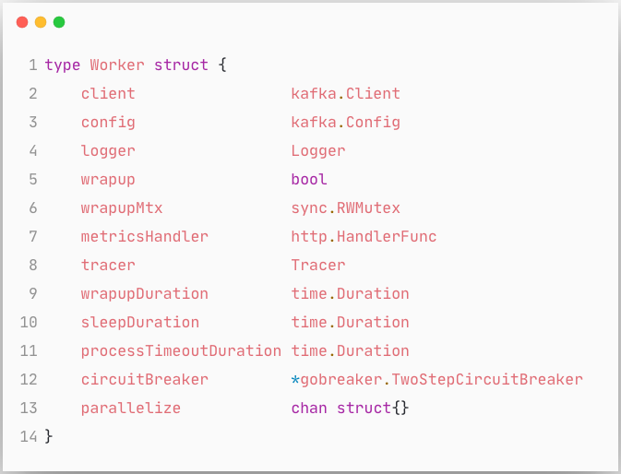
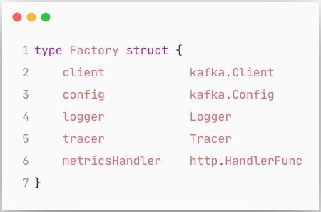
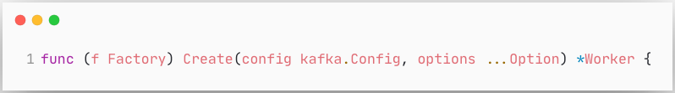
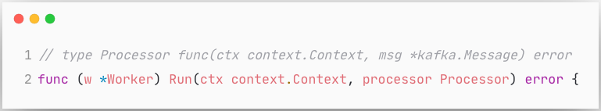
Worker

Slide 28
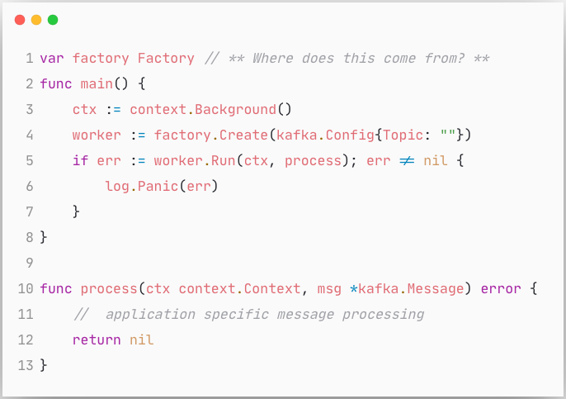
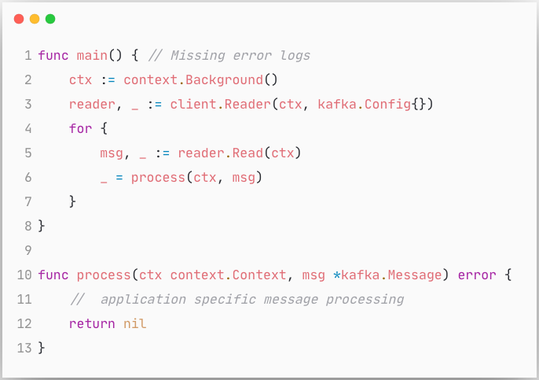
Worker

Slide 29
SERVER
WORKER
db

Slide 30
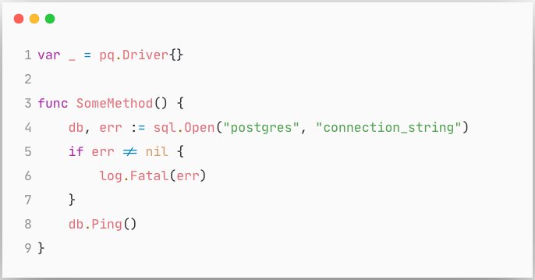
db
Connection Reuse
Tracing
Max and Idle Connections
sqlx
context

Slide 31
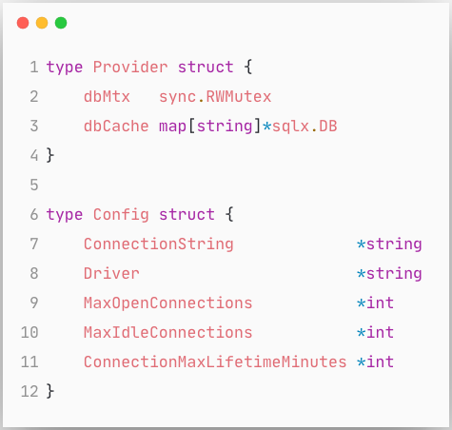
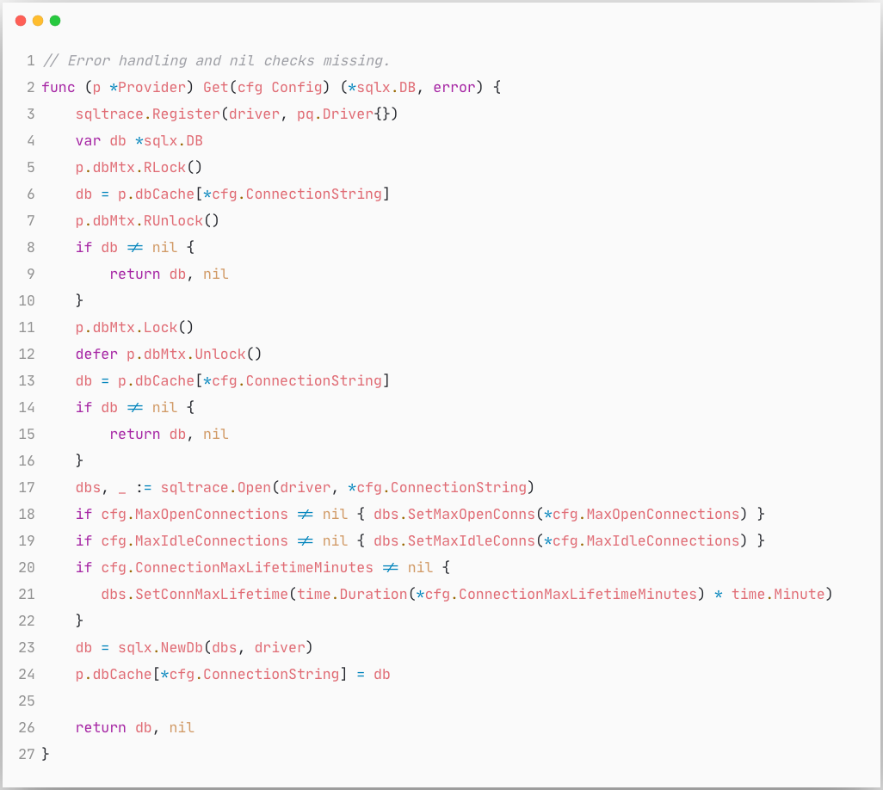
db
Notes:
sqltrace "gopkg.in/DataDog/dd-trace-go.v1/contrib/database/sql"

Slide 32
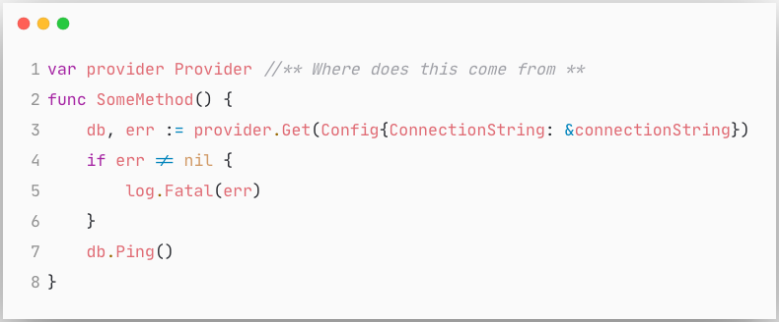
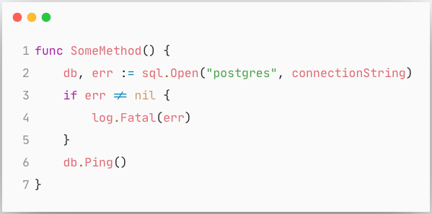
db

Slide 33
SERVER
http
WORKER
db

Slide 34
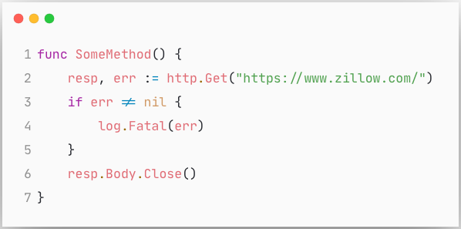
http client
Timeouts
Retries
Tracing
Context Propagation

Slide 35
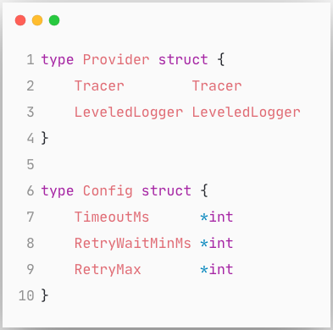
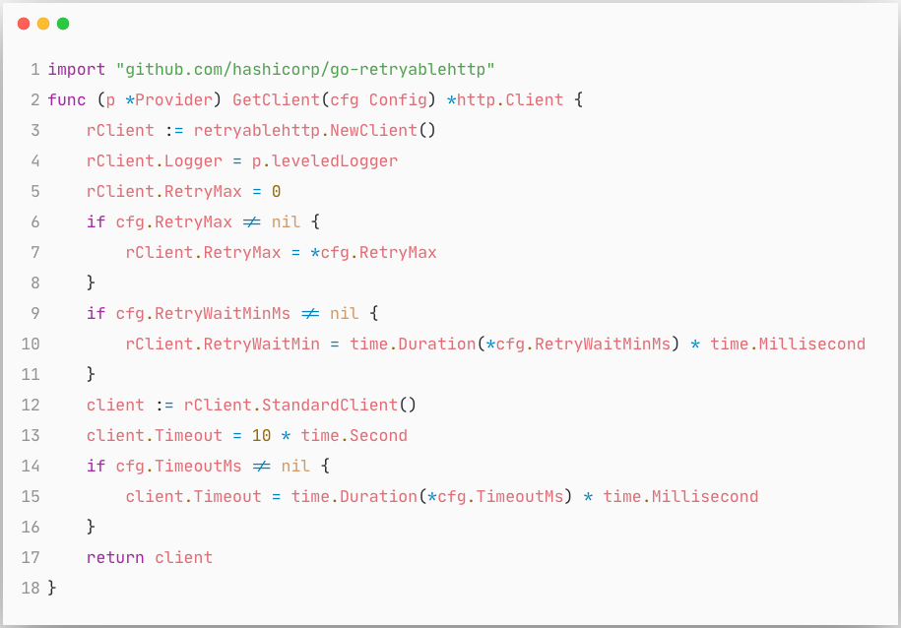
http client

Slide 36
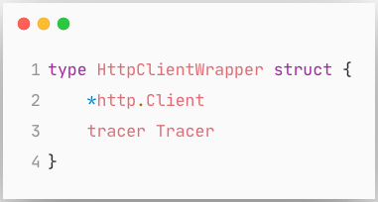
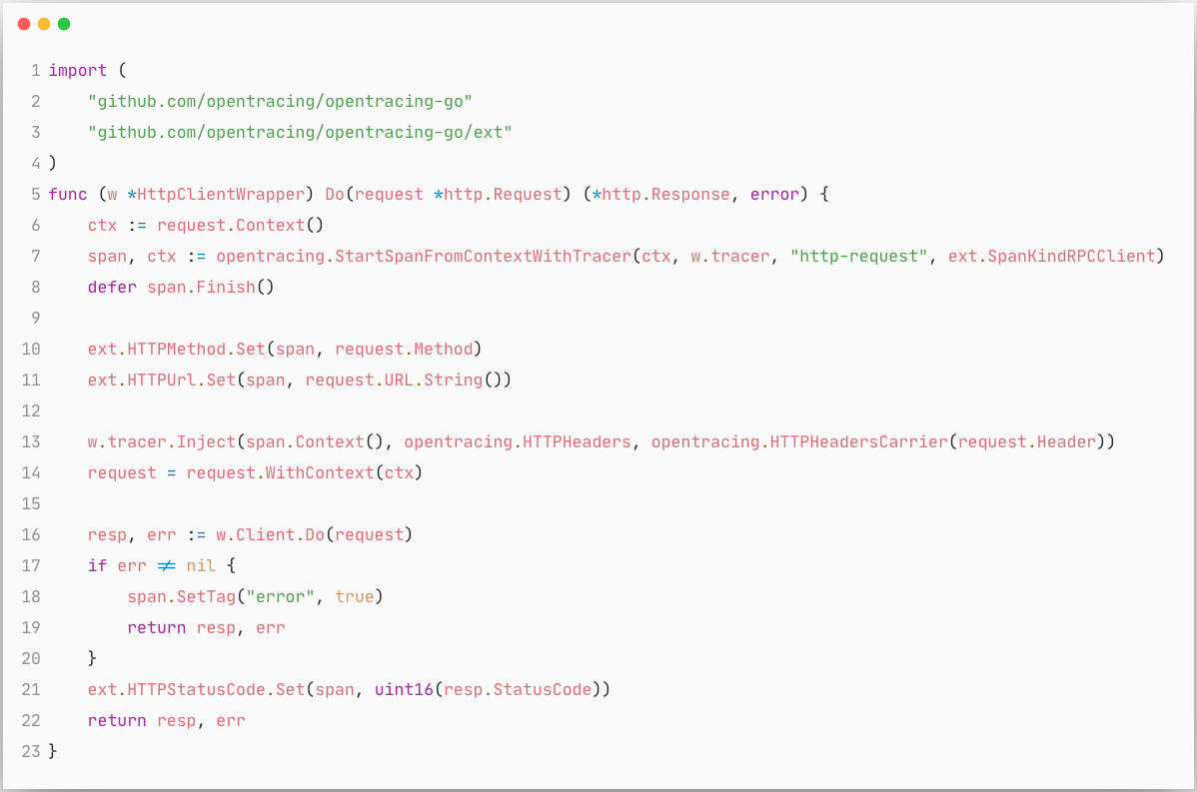
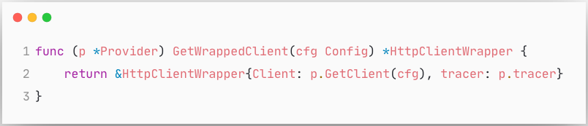
http client

Slide 37
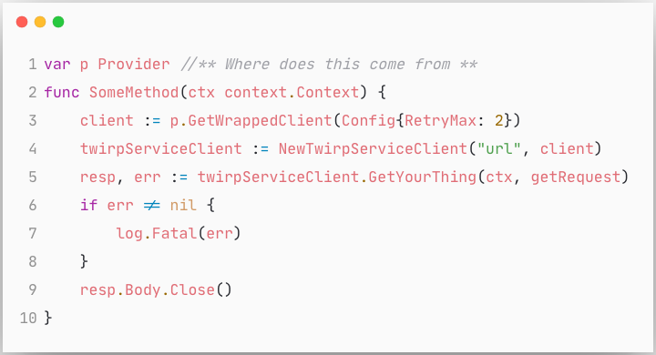
http client

Slide 38
SERVER
http
kafka
WORKER
db

Slide 39
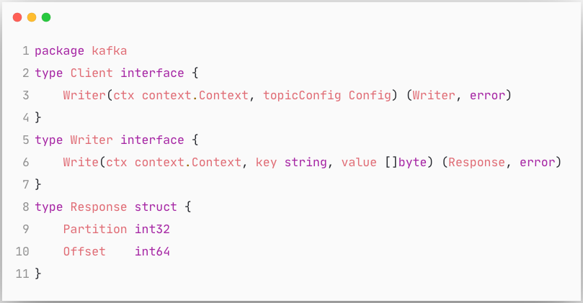
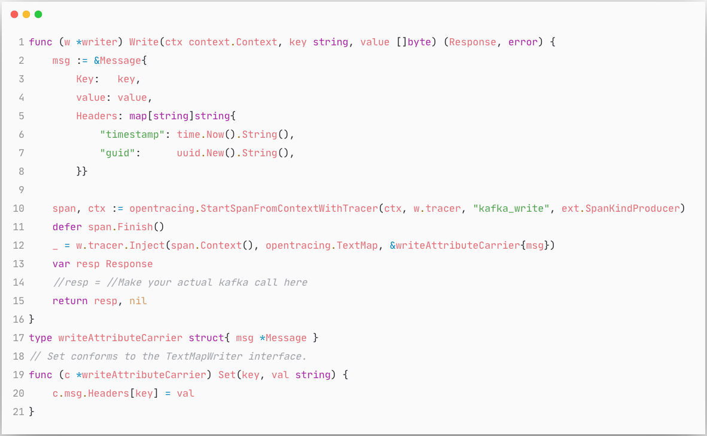
kafka write

Slide 40
Logging
Tracing
Metrics
Context
Config

Slide 41
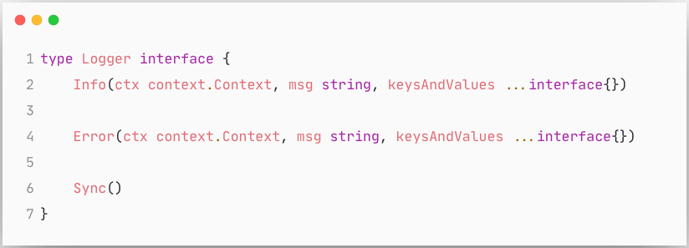
Logger

Slide 42
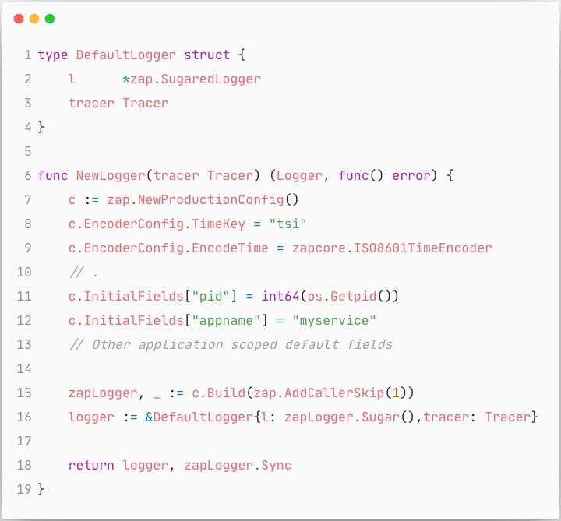
Logger

Slide 43


Logger

Slide 44


Configuration

Slide 45


Configuration : AppConfig
Notes:
Testable configuration

Slide 46
Composition
ServerFactory
WorkerFactory
DBProvider
HttpClientFactory
KafkaClient
RedisClient
Logger
Tracer
Statsd
AppConfig

Slide 47



Example

Slide 48



WIRE: https://github.com/google/wire
“Wire is a code generation tool that automates connecting components using dependency injection.”
Handwritten
Generated

Slide 49

Wire

Slide 50

Wire

Slide 51


Wire

Slide 52

Wire

Slide 53
Example

Slide 54


Example
Generated

Slide 55
Example

Slide 56


Testing

Slide 57


Testing

Slide 58

Testing

Slide 59
Goals
Consistency
Every service should look and feel the same.
Maintainability
Upgrades should not be a multi year effort
Resiliency
100% SLA 🤪
Observability
Logging, Metrics, Tracing
Testability
Yeah, unit testing is cool, but have you tried integration testing?

Slide 60

Thank You

